Slide 1
INFO 250 Information Visualization
Week 3B: Ontologies of visualization
Classification of Visualization (III)

Slide 2
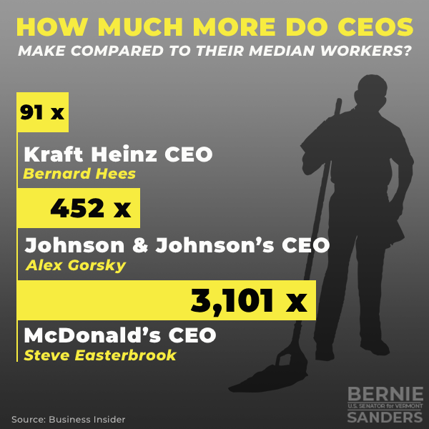
An exercise: How would you evaluate this graph?
Notes:
quotient

Slide 3
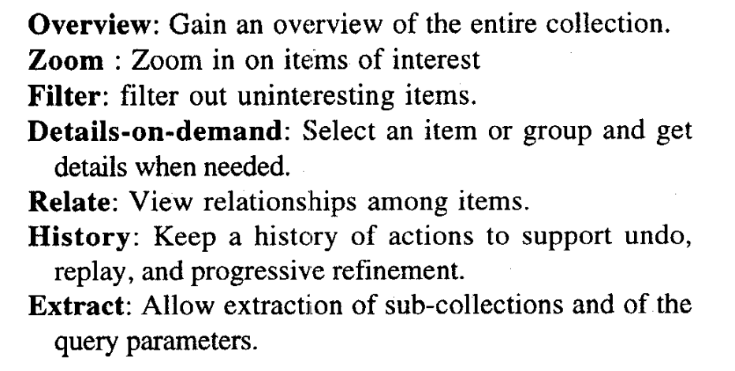
Shneiderman’s list of visualization user tasks
https://drum.lib.umd.edu/bitstream/handle/1903/5784/TR_96-%C3%82%C2%AD%C3%A2%20%2066.pdf.?sequence=1

Slide 4
Example I: Google Maps
https://www.google.com/maps/

Slide 5
Example I: Google Maps
https://www.google.com/maps/
We can apply this system to any information system with a visual interface.
Google Maps is designed for a broad spectrum of user needs from a very large user base.
Overview
Zoom
Filter
Details-on-demand
Relate
History
Extract

Slide 6
Example II: NYT Mapping Segregation
https://www.nytimes.com/interactive/2015/07/08/us/census-race-map.html

Slide 7
Example II: NYT Mapping Segregation
https://www.nytimes.com/interactive/2015/07/08/us/census-race-map.html
Overview
Zoom
Filter
Details-on-demand
Relate
History
Extract

Slide 8
Example III: A regular (static) line chart
https://documentation.devexpress.com/WindowsForms/2976/Controls-and-Libraries/Chart-Control/Fundamentals/Series-Views/2D-Series-Views/Point-and-Line-Series-Views/Line-Chart

Slide 9
Example III: A regular (static) line chart
https://documentation.devexpress.com/WindowsForms/2976/Controls-and-Libraries/Chart-Control/Fundamentals/Series-Views/2D-Series-Views/Point-and-Line-Series-Views/Line-Chart
Overview
Zoom
Filter
Details-on-demand
Relate
History
Extract

Slide 10
User tasks in information visualization
The user task (interactivity) is a function of:
Dynamicity
Complexity
Nature of questions
Type of information system
Visualization tool
Interactive graphs can be very different from static graphs, but they largely follow the same designing principles.

